Slide 1
Applied Micro Methods
Overview and Regression Discontinuity

Slide 2
Brief Overview of Reduced-Form Methods
Some questions in applied micro are descriptive in nature:
How liberal (or conservative) are media outlets?
What has happened to income inequality over time?
But: Many (most?) of the questions we have are causal in nature:
Do labor training programs increase employment, or earnings?
Does additional, or higher-quality education increase earnings?
Does media slant affect vote outcomes?
Do mergers of gasoline retailers increase prices?
Do more developed financial systems improve economic growth?
What is the effect of family environment on outcomes?
Does neonatal exposure to pollution affect outcomes?
Does additional policing reduce crime?
Do Israeli counter-terrorism responses deter suicide bombings?
Does neighborhood affect propensity to commit crimes?
Does the threat of lawsuits cause doctors to practice defensive medicine?

Slide 3
How are these questions answered? By looking at the data!
Typical observation: Variable A is correlated with Variable B
Example: People who watch Fox News vote for conservative politicians
4 Potential Explanations:
A causes B
Watching Fox News causes people to vote for conservatives
B causes A
Supporting conservative politicians induces people to watch Fox News (case-in-point: the debates!)
iii) C causes A and B
An underlying dislike of government causes people to both watch Fox News and support conservatives
Correlation is spurious
Example from the investment world: Super Bowl winner is correlated with future market return
Rule: If the team that wins the Super Bowl has its roots in the original NFL, the market will increase. Otherwise, the market will decline
Evidence: Following this rule (buying index or treasuries based on outcome) would have outgained the S&P 500 by more than a factor of 2!
Why? Data Mining!

Slide 4
How can we distinguish the “A causes B” explanation from the others?
Gold Standard: Randomization
Experiment: We randomly assign some in a population to receive treatment A, and randomly assign others in the same population to not receive A
Why does this work? Randomization ensures that any confounding factors C are orthogonal to the treatment, as is the underlying propensity for outcome B
Bonus: If variation in A is random, we don’t need to worry about specifying the appropriate model with appropriate assumptions (i.e., all that “elaborate superstructure” stuff), or measuring and controlling for all relevant determinants, etc.
Note: This doesn’t mean there is no need for theory!

Slide 5
Difficulties with implementing the gold standard:
Expense (e.g., returns to schooling)
Infeasibility (e.g., mergers)
Ethics: Do you really want to randomly break up families?
May not tell us what we want to know (e.g., randomly breaking up families)
Attrition (e.g., the Negative Income Tax Experiments)
Non-compliance (e.g., studying the effect of a low-fat diet when subjects don’t stick to the diet, or a national study on the effect of calcium and vitamin D on bone strength when the control group also took supplements)

Slide 6
Second-best solution for empirical microeconomists:
Find “natural experiments”, or as-good-as-random variation in the treatment
Alternative: Use difference-in-difference research design, which has less stringent identifying assumptions than a cross-sectional comparison
3 approaches:
Regression Discontinuity Design
Instrumental Variables
Difference-in-Difference
Notes:
Aside: No where do we attempt to model the relationship between A, B, and C, or understand “the data generating process”
In other words: If you want to estimate the effect of A on B, you had better have as-good-as-random variation in A, or show that the identifying assumptions of difference-in-difference appear to hold
If you don’t have exogenous variation in A, then the only way to determine the causal effect of A on anything is to add additional information (i.e., structure) to the problem, and hope you’re right.
View: I’d rather be right about the causal effect on some population, than to think (assume?) I know the answer for everyone, and be wrong.

Slide 7
Back to applied micro research:
My view: If you don’t have exogenous variation in A, the only thing you can do is theory (i.e., tell stories)
Additional benefit of reduced-form methods: The identifying assumptions and comparison are simple and transparent, and there are few ways for incentivized researchers to affect the nature or apparent robustness of the results
Leamer approach: Report a range of estimates that result from doing things in all different ways (models, functional form, controls, etc.)
Natural experiment approach:
i) Provide an institutional explanation for why the variation in treatment is as-good-as-random
ii) Show empirical evidence that the variation in A is as-good-as-random and/or that the identifying assumptions hold
iii) Show results using the raw data
iv) Demonstrate robustness to the (relatively few) arbitrary decisions you had to make, and attempt to address all other non-causal stories

Slide 8
One such approach: Regression Discontinuity Design
Description: Treatment is determined at least in part by the value of a covariate—specifically, whether it lies on one side of a fixed threshold or the other
Example: What are the returns to university quality?
Identification Problem: It’s difficult to distinguish between the effect of attending a higher-quality school, and the effect of being the type of person who attends a higher-quality school
Consider a cross-sectional regression
Ln(earnings) = B0 + B1(Attend_Higher_Quality_School) + e
Estimate (B1) = true effect of attending higher quality school + bias due to correlation between attending better schools and other factors that increase earnings (more educated and higher-income parents, more motivation, higher ability, etc.)
Estimate overstates the positive returns to school quality
What if we control for Xs? Do we know what drives the remaining variation?
Rule to live by: Know Thy Variation, and Let Thy Variation Be As-Good-As Random
Notes:
Conditional Independence is not a useful assumption in empirical and applied work.

Slide 9
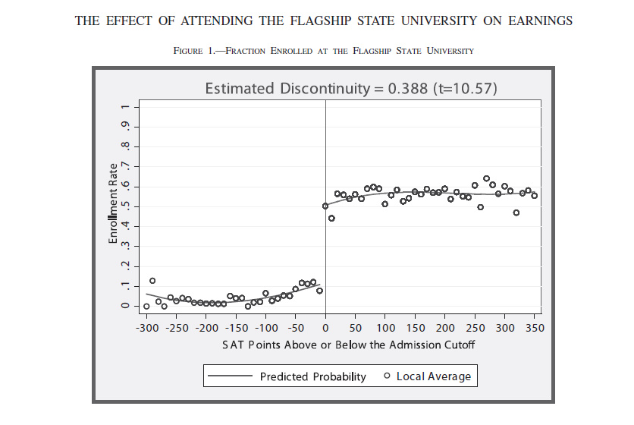
Intuition of RDD: individuals on either side of the admission cutoff would have had similar earnings profiles years later, except for the effect of attending the flagship
Put differently: Within an arbitrarily close distance to the threshold, whether or not you attended the more selective school is as-good-as-random
Notes:
You want to see a discontinuous increase in probability of treatment at the cutoff.

Slide 10
Identifying Assumption of Regression Discontinuity Design:
All other determinants of the outcome vary smoothly across the threshold
When does this assumption likely hold?
i)When individuals cannot manipulate where they are relative to the cutoff
(it helps if they don’t even know where the cutoff is!)
ii) When nothing else besides the treatment changes at the cutoff
(e.g., studying the effect of price discounts at age 65 probably won’t work)
Practical implementation: We control smoothly for the running variable (make sure you are fitting the data well!), thereby controlling for all other determinants of treatment and obtaining an estimate of the expected difference in treatment (enrollment) and outcomes (log earnings) for individuals barely below, and barely above the cutoff
Example of estimating equation:
Outcome = b0 + b1(SAT*belowcutoff) + b2(SAT*belowcutoff)^2 + b3(SAT*abovecutoff) + b4(SAT*abovecutoff)^2 + b5*abovecutoff + e
Notes:
You can never prove that your identifying assumption holds. However, you can provide valid institutional reasons that the assumption does hold and show empirical evidence that is consistent with this idea. The example equation above shows how you estimate the reduced-form RD effects. Important to note, in the example, the “above the cutoff” variable does not signify treatment, it means that you are more likely to receive treatment. Remember, the point of RD is to overcome the selection problem.

Slide 11
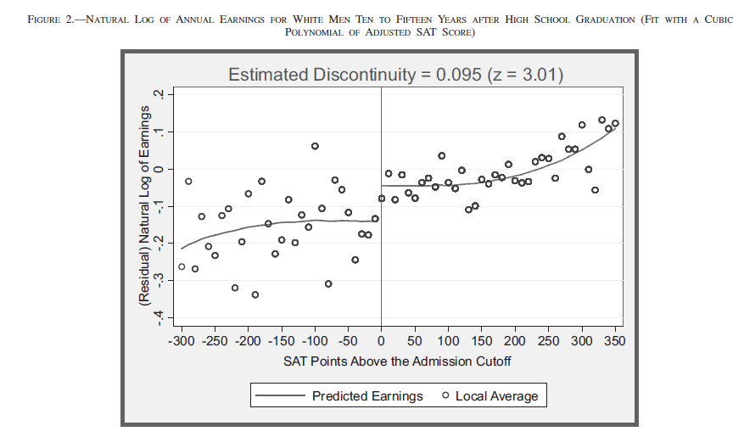
Hoekstra Econometrics: Eyeball Test!
Notes:
Aside: Estimate the line of best fit with the underlying data, not local averages.

Slide 12
Tests of RDD Identifying Assumption:
Look for discontinuities in pre-determined or exogenous characteristics
Example: Is there also a discontinuity in parental education, parental income, etc., at the admission cutoff?
Note #1: If there is a discontinuity we could control for Xs, BUT…
Note #2: Statistical power… (see Lindo et al. paper)
2) Show RD estimates with and without controls
Good Outcome: Estimate is the same
=> treatment is orthogonal to controls, at least once you control for running variable
Bad Outcome: Estimate changes in a significant way
=> there is manipulation around the cutoff, as controls are systematically correlated with being above the cutoff, conditional on the running variable
Concern: If treatment and control vary on things we can observe, what about things we can’t observe?
Notes:
Exogenous characteristics are things that are not going to be affected by treatment. You can’t test everything, but you can test observables. If there is a significant discontinuity in several exogenous variables, then there is probably some manipulation in the data. Consequently, it is more likely that the identifying assumption does not hold, so you will not be able to employ RD. By adding controls, you are trying to provide evidence that the variation in treatment is as-good-as-random.

Slide 13
Tests of RDD Identifying Assumption:
3) Look for “lumpiness” in the density function
Good versus bad…
4) Look for discontinuities in the outcome at fake cutoffs

Slide 14
RDD Robustness Tests
What is the right functional form?
Primary rule: LOOK at the data and see how well you are fitting it
Beyond that: show results from multiple functional forms (remember, when you make arbitrary decisions, show it both ways)

Slide 15
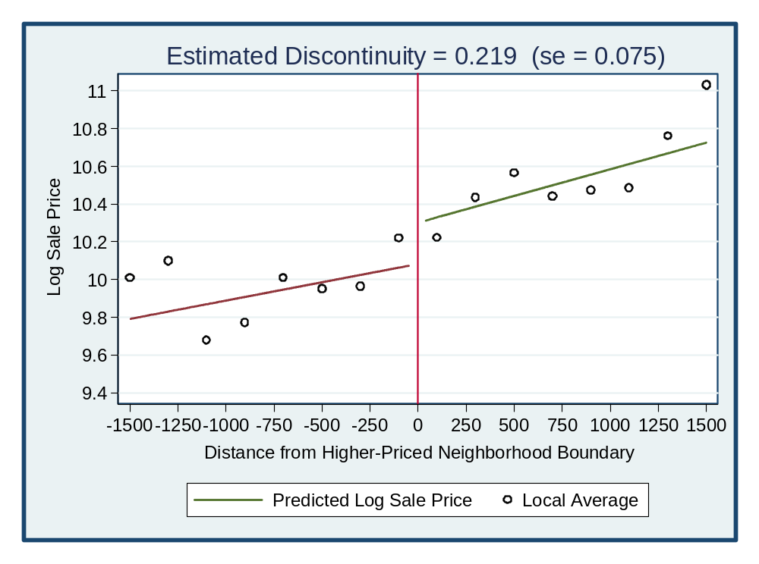
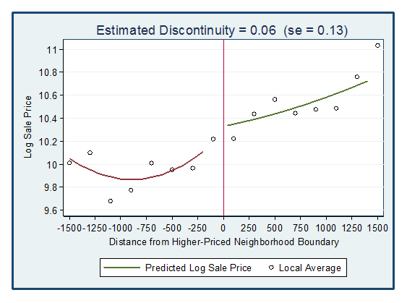
Notes:
When a project fails, and you can’t overcome the problem, then move on!

Slide 16
RDD Robustness Tests
ii) What is the appropriate bandwidth?
Tradeoff:
Positive: Bigger bandwidths => more precise estimates and less susceptibility to noise
Negative: Bigger bandwidths => observations far from cutoff can influence RD estimate
Champagne solution: cross-validation method (see Imbens & Lemieux, 2008); what is the optimal bandwidth?
Miller High Life solution: Show all data with large bandwidth, and then present estimates for narrower bandwidths

Slide 17
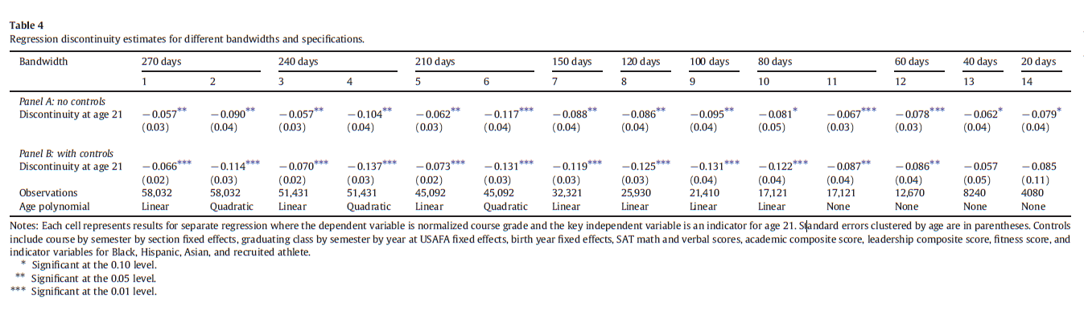

Slide 18
More RDD Issues:
Standard Errors
When running variable is discrete, you need to cluster standard errors at the level of the “clusters” in the running variable (Lee and Card, 2007)

Slide 19
More RDD Issues:
Interpretation: Fuzzy versus Sharp RDD
Notes:
Fuzzy: At the cutoff, the discontinuity in the probability of treatment is less than one. If this happens, then we just reweight the estimated effect of the treatment on the outcome. This reweighted estimate is known as the local average treatment effect.
Sharp: At the cutoff, the discontinuity in the probability of treatment is one. This is the average treatment effect for people near the cutoff.

Slide 20
Local Average Treatment Effect (LATE) (see Angrist, Imbens, and Rubin, 1996)
Sharp RD: Obtain average treatment effect for individuals near cutoff
Fuzzy RD: Obtain local average treatment effect (LATE), interpreted as the average effect on compliers near the cutoff
Four types of individuals: Always-takers, Never-takers, Compliers, and Defiers
Assignment
Control Treatment
Treated Always-Takers/Defiers Compliers/Always-Takers
Actual Status
Not Treated Compliers/Never-Taker Never-Takers/Defiers
Note: Under the assumption that there are no defiers, which is what we always assume, the LATE captures the treatment effect for compliers.
Downside: We don’t actually know who they are ☹

Slide 21


Slide 22
RDD: Final thoughts
Upsides:
-Under identifying assumption, it offers a clean and transparent way of getting at a causal effect
-Identifying assumption is testable!
(Look for discontinuities in pre-determined or exogenous characteristics, Show RD estimates with and without controls, Look for “lumpiness” in the density function, Look for discontinuities in the outcome at fake cutoffs)
Downsides:
-Obtaining precise estimates can be difficult
(You need to have enough observations around the cutoff.)
-Estimates are only relevant for population near the cutoff, and, additionally in fuzzy RDD, are only relevant for compliers near the cutoff

